Slide 1

2019 Trane Latin America Sales Conference

Slide 3

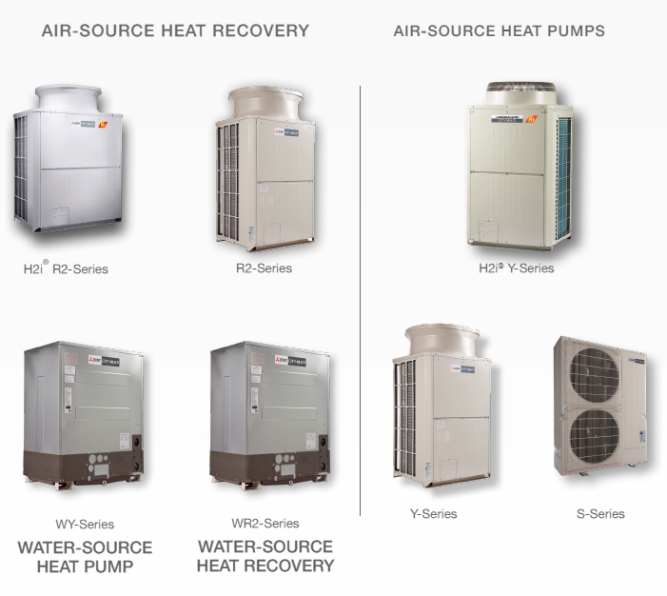
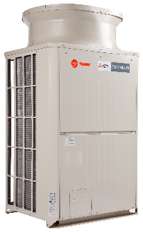
Portfolio de Productos No UL
Serie-Y
Generacion “K” Non-UL
Bomba de Calor
Hasta 563MBH (47 Toneladas)
Hasta 50 unidades interiores
Distancia Max. de90 mts de primera derivacion
Coneccion de unidades interiores hasta 130%
Largo de tuberia total = 1000 mts
Diferencia de elevacion entre unidades interiores= 30 mts
Max. EER = 14.7
Serie-S
Generacion “K” Non-UL
Bomba de Calor
3.5, 4 y 4.5 Toneladas
Hasta 12 unidades interiores
Distancia Max. de90 mts de primera derivacion
Coneccion de unidades interiores hasta 130%
Largo de tuberia total= 300 mts
Diferencia de elevacion entre unidades interiores= 15 mts
Max. EER = 15.28
3

Slide 4


Portfolio de Productos UL
Serie-R2 – “K” “L”
Recobro Energetico – 2 tuberias
Hasta 336MBH (28 Toneladas)
Hasta 50 unidades interiores
Max. 110 mts from ODU to first BC
Max. 60 mts from BC to UI
Combination IUs up to 150% (200%)
Max. pipe length = 937 mts
Max. height diff. UIs = 30 mts
Max. EER/IEER “K” = 15.5 / 22.1
Max. EER/IEER “L” = 14.8 / 28.1
Y-Series – “K” “ L”
Heat-Pump
Up to 360MBH (30 Tons)
Up to 50 indoor units
Max. 90 mts from first derivation
Combination IUs up to 130%
Max. pipe length = 1000 mts
Max. height diff. UIs = 30 mts
Max. EER/IEER “K” = 14.2 / 21.3
Max. EER/IEER “L” = 16.4 / 28.1
S-Series “K”
Heat-Pump
3, 4 y 5 Tons
Up to 12 indoor units
Max. 30 mts from first derivation
Combination UIs up to 130%
Total piping length = 300 mts
Max. height diff. UIs = 15 mts
Max. EER/IEER “L” = 14.2 / 21.0
4
4

Slide 5
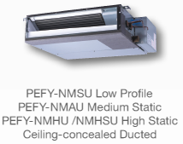
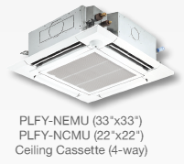
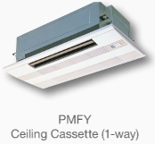
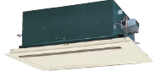
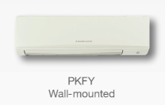
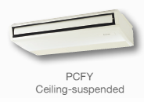
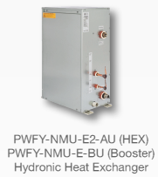
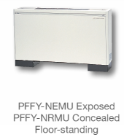
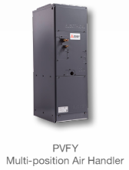
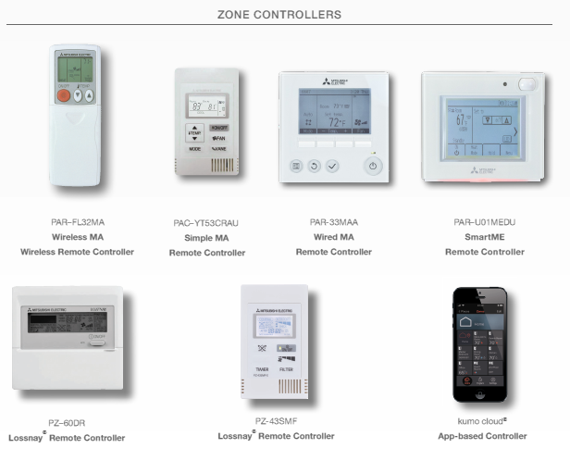
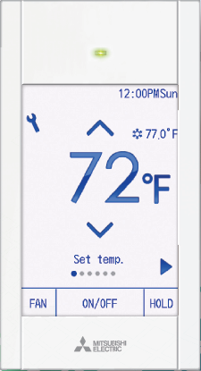
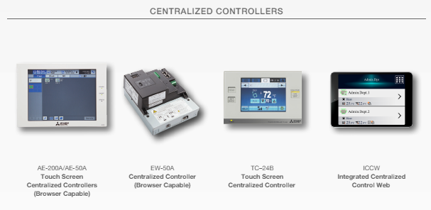
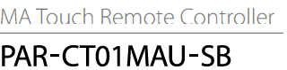
Portfolio de Produto
Nn UL Solamente
PLFY-VLMD
Ceiling Cassette (2-way)
Sin Ducto 6-48 Mbh
Ductado 6-96 Mbh
Only
Only
5
5
*Todas las unidades interiores existen en versión UL y No-UL, a excepción de las mencionadas. Todos los controles son UL.
5

Slide 6
Caracteristicas Claves
Se puden conectar hasta 50 unidades
Modulos disponibles hasta 188 MBH (~16 Toneladas) con capacidades en modulos combinados de 563 MBH (~47 Toneladas).
Tratamiento anticorusivo Blue Fin disponible en toda las unidades.
Operacion garantizada hasta 125.6ºF (52ºC) con 100% refrigeracion.
Uso efectivo del espacion con una de las dimensiones mas pequenas y peso mas liviano.
Garntia standard de 7 anos en compresor y 1 ano en partes con garantia extendida de 10 anos.
Unico sistema acumulador y separador de aceite de alta eficiencia
Diametro mas pequeno en la industria (hasta un 10% de reduccion en costo).
Puede operar a 4% de capacidad con rendimiento guarantizado.
Usa derivaciones “T” en vez de derivacion “Y” que reduce el costo de instalacion.
El unico sistema de Recobro Energetico de 2 tuberias en vez de 3 tuberias en LAR.
Todo los controladores individuales pueden operar hasta 16 unidades interiores.
Sistema certificado de aporcionamiento de energia.
Integrated Centralized Control Web puede controlar hasta 2000 unidades
Programas de selección de alto rendimiento que incluyen actualizaciones en línea y capacidades para compartir, acceso instantáneo a catálogos, presentaciones, archivos REVIT y AutoCAD
Herramientas de Mantenimiento y Solucion de problemas avanzada.

Slide 7
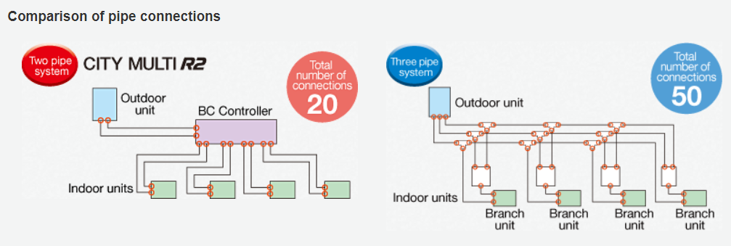
Caracteristicas Claves
Todas las demás compañías de HVAC tienen separadores y acumuladores de aceite muy pobres en sus unidades exteriores, lo que generalmente lleva a una migración de aceite de hasta el 90% en promedio, lo que hace que tengan que instalar un tercer tubo para la línea de gas caliente.
Sin embargo, Mitsubishi agrega un separador y acumulador de aceite a sus unidades exteriores, lo que nos permite no tener que agregar un tercer tubo para la recuperación de calor, en lugar de eso, se usa un controlador BC = menos tubería, menos conexiones, menos costos de instalación.
EL UNICO SISTEMA DE 2 TUBERIA DE RECOBRO ENERGETICO!
Notes:
The problem with having very poor oil separators and accumulators and adding that extra heating gas line for the oil recovery cycle, this causes zone-temperature drift during recovery cycles and affects the energy efficiency of the unit especially at capacities less than 75% which is where most units operate 98% of the time.
Since in the Mitsubishi model only 6% of oil migration occurs they do not require regular oil recovery cycles to return the oil. Also with less refrigerant volumes and velocities during mode change over, oil recovery is minimized. All this allows for our units to operate more efficiently at lower capacities than any other system and for some outdoor units to even run efficiently at 6% capacity.
BC Controller functions
Separates refrigerant into gas and liquid
Ensures units in heating receive superheated gas
Ensures units in cooling receive sub-cooled liquid

Slide 8

Caracteristicas Claves.
Otro gran beneficio es que, si una unidad interior falla debido a algún motivo, el sistema continuará funcionando sin tiempo de inactividad.
¡El sistema puede funcionar eficientemente al 4% de su capacidad! ¡Algo que los competidores NO PUEDEN HACER!
Un máximo de 6% de migración de aceite ...
Notes:
The problem with having very poor oil separators and accumulators and adding that extra heating gas line for the oil recovery cycle, this causes zone-temperature drift during recovery cycles and affects the energy efficiency of the unit especially at capacities less than 75% which is where most units operate 98% of the time.
Since in the Mitsubishi model only 6% of oil migration occurs they do not require regular oil recovery cycles to return the oil. Also with less refrigerant volumes and velocities during mode change over, oil recovery is minimized. All this allows for our units to operate more efficiently at lower capacities than any other system and for some outdoor units to even run efficiently at 6% capacity.
BC Controller functions
Separates refrigerant into gas and liquid
Ensures units in heating receive superheated gas
Ensures units in cooling receive sub-cooled liquid

Slide 9
Caracteristica Claves
Calculacion de tuberia para un sistema de 32 HP
 |  |  |  |  |  | Total Length (m)
Pipe Size (inch) | Pipe Size (mm) | Pipe Type | Weight per meter | Cost per kg (BRL) | Cost per meter (BRL) | Mitsubishi UL | TVR LX | LG Multi V IV | TVR Select | Mitsubishi Non-UL
3/8 | 9,52 | Flexible | 0,195 | 42,9 | 8,4 |  |  | 160 | 160 | 80
1/2 | 12,7 | Flexible | 0,266 | 42,9 | 11,4 | 240 | 240 | 80 |  | 160
5/8 | 15,87 | Flexible | 0,337 | 42,9 | 14,5 | 200 |  | 160 | 240 | 200
3/4 | 19,05 | Flexible | 0,408 | 42,9 | 17,5 | 30 | 200 | 40 | 40 | 30
7/8 | 22,22 | Rigid | 0,478 | 44,9 | 21,5 | 80 | 30 | 30 | 30 | 80
1 | 25,4 | Rigid | 0,549 | 44,9 | 24,7 |  | 80 | 80 | 80
1 1/8 | 28,57 | Rigid | 0,620 | 44,9 | 27,8 | 40 |  |  |  | 40
1 1/4 | 31,75 | Rigid | 0,691 | 44,9 | 31,0 |  | 42 | 40 | 40
1 1/2 | 38,1 | Rigid | 0,833 | 44,9 | 37,4 |  | 30 | 30
1 5/8 | 41,27 | Rigid | 0,904 | 44,9 | 40,6 | 30 |  |  | 30 | 30
Piping Cost |  |  |  |  |  | 10203 | 11280 | 10244 | 10583 | 9960
Inst. Cost Red. |  |  |  |  |  | 2% | 12% | 3% | 6% | Base
Puede haber un ahorro de mas de 10% ….

Slide 10
Caracteristicas Claves
Sistemas Modulares tienen mejores eficiencias.

Slide 11




Caracteristicas Claves
Mitsubishi tiene los mejores productos en esta categoria.
Nivel de sonido mas bajo y eficiencia mas alta.
Fabricante VRF Mini | 27,3 MBH |  | 35,8 MBH |  | 38,2 ~ 42,7 MBH |  | 47,8 MBH |  | 52,9 MBH
 | Noise Level | EER (W/W) | Noise Level | EER (W/W) | Noise Level | EER (W/W) | Noise Level | EER (W/W) | Noise Level | EER (W/W)
TVR Mini | - | - | 57 | 3,92 | 57 | 3,69 | 57 | 3,54 | 57 | 3,43
S-Series | - | - | - | - | 49 | 4,48 | 50 | 4,05 | 51 | 3,43
Mini Multi V | - | - | - | - | 50 | 3,39 | 52 | 3,70 | 52 | 3,71
Serie S | 54 | 3,81 | - | - | 55 | 3,70 | 55 | 3,46 | 55 | 3,31
Specification

Slide 12
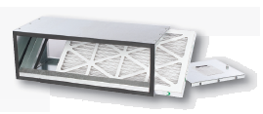
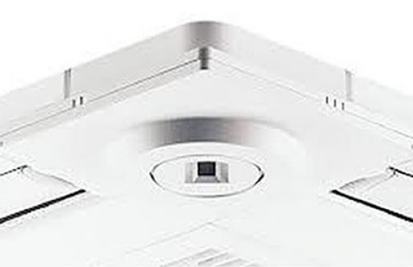
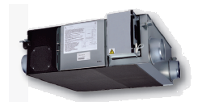
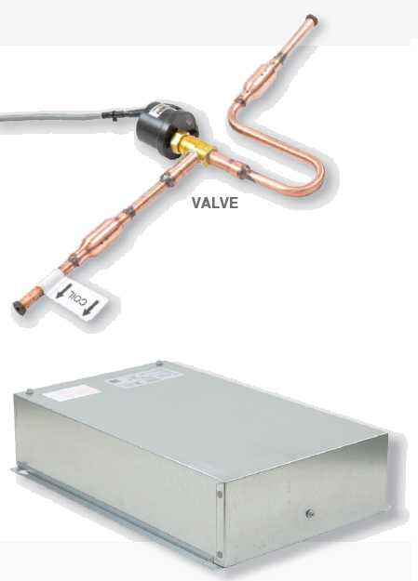
Caracteristicas Claves
High-Wall 5,8 ~ 38,2 MBH | Fancoil low, mid, high 5,8 ~ 76,4 MBH | 4-Way Cassete standard and compact 5,8 ~48 MBH
1-Way cassette 7,5 ~ 15,4 MBH | 2-way cassette 7,5 ~ 48 MBH | Ceiling 15,4 ~48 MBH
As low as 29 dB(A)
Opt. MERV 8 hasta 13 filters
As low as 22 dB(A)
3D I-See sensor
As low as 27 dB(A)
Specification
Specification
Specification
Specification
Specification
As low as 29 dB(A)
Specification
Console 7,5 ~ 24 MBH | AHU or LEV kit AHU: 12 ~ 54 MBH LEV kit: 4,8 ~ 240 MBH | Hydronic heat exchanger R2 Series, 36 ~ 72 MBH | Energy recovery ventilator Lossnay 500 ~ 2000 m³/h
Best enthalpy efficiency
Specification
Specification
Specification

Slide 13
Caracteristicas Claves
Company | Range of operation in Cooling
Mitsubishi – Y-Series | -5 ~ 52 C
Daikin - VRV IV | -5 ~ 43 C
Samsung – DMV S | -5 ~ 49 C
LG – Multi V IV | -5 ~ 43C
Los dias mas calientes no son un problema…

Slide 14
Caracteristicas Claves
Company | Warranty
Mitsubishi | Standard 7 years compressor 1 year parts Extended 10 years compressor 10 years part
Daikin | 5 years compressor 2 years parts
Samsung | 5 years compressor 1 year parts
LG | Standard 5 years compressor 2 year parts
Calidad con Responsibilidad…

Slide 15
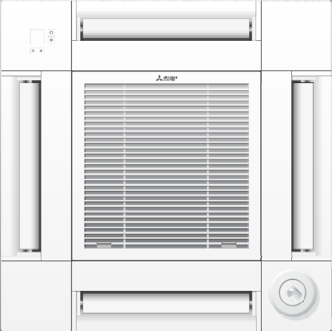
Caracteristicas Claves
3D i-See Sensor
3D i-See sensor se usa para determinar la ocupacion
OperacionAuto-Off
Draft-less Mode – Individual automatic louver direction
Cassettes Nuevos
UL
PLFY-EP**NEMU-E
PLFY-P**NFMU-E
Non-UL
Optional

Slide 16
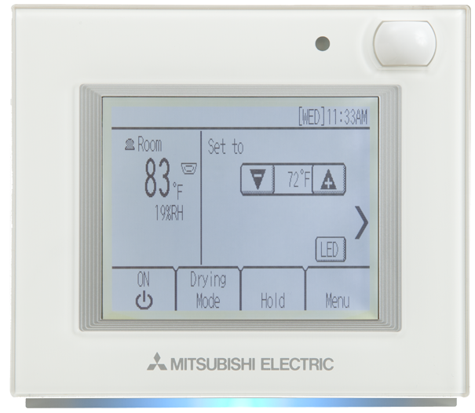
Caracteristicas Claves
PAR-U01MEDU-K
Built-in Sensors
Occupancy
Temperature
Humidity
Brightness
Touch Screen
Weekly Schedule (with Mode)
Timed Override & Permanent hold of schedules
Dual set point with extended temp range
Energy saving function (occupancy based control)
General equipment monitoring (requires AHC)
Displays room name
ME Style (M-NET addressable)
SMART ME
Mucho mas que un termostato tipico…
Notes:
Additional Features:
Grouping configuration (up to 16 indoor units and one AHC in a group)
Connected system search function
Lossnay® interlock setting
Screen cleaning lock out
Screen calibration
Offsets for Temperature and Humidity sensor displays
Occupancy and Brightness sensor calibration
Color Indicator On/Off and Customization
Indoor unit function settings
Extended set temperature range (dependent on connected system)
Passwords
9999 Service (Default)
0000 User (Default)

Slide 17
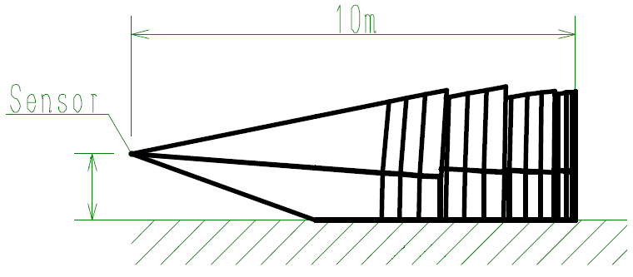
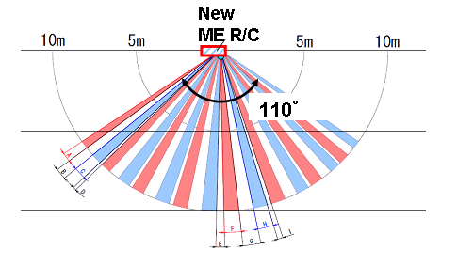
Caracteristicas Claves
Funccion Ahorro Energetico
Occupancy Sensor Detectable angle
Unoccupied settings
・Vertical
32.8ft
(10m)
New ME R/C
Upper：11.2°
31°
・Horizontal
Lower：19.8°
32.8ft
(10m)
16.4ft
(5m)
16.4ft
(5m)
32.8ft
(10m)
3.9ft(1.2m)
or
4.9ft(1.5m)
Mucho mas que un termostato tipico…
Notes:
Occupied: Returns to normal operation
Unoccupied (pick one):
Turn IDU Off
Change Mode to SETBACK
Offset the set temperature
Change Fan Speed to Low
Force IDU into Thermo-off
Schedule “Active” times for Energy Savings and combine with brightness sensor to help determine occupancy

Slide 18
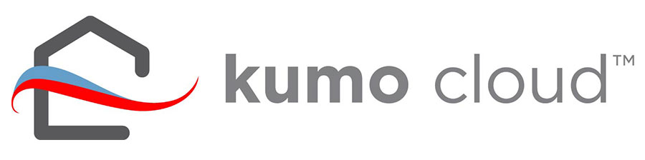
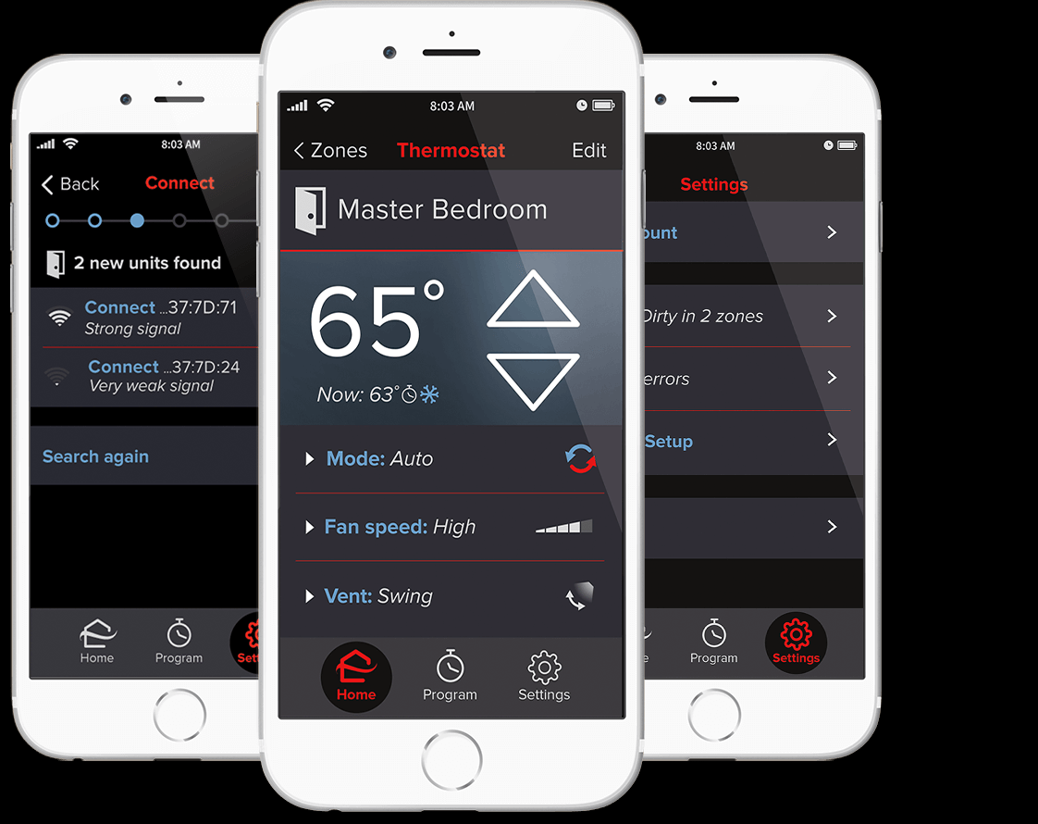



Caracteristicas Claves
Kumo Cloud
Compatible with CITY MULTI and M and P-Series units
Smaller unit measuring 2.9” x 1.8” x 0.7”
Velcro mounting strip for easier mounting and removing
Easy to connect the device to your router using the kumo cloud app
App compatible software platforms:
— Apple iOS 8.0 or later
— Android 4.1 or later
— Fire OS 4.1 or later
Intuitive settings for simplified use:
—Group units together
—Organize groups into sites
—Batch command units
Error and filter status pop-up
Controla su sistema remotamente….!

Slide 19

Kumo Cloud

Slide 20


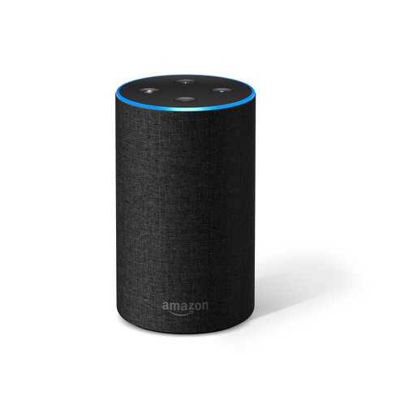

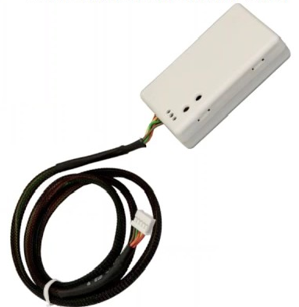
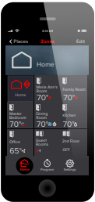
Caracteristicas Clave
Kumo Cloud y integracion Alexa
“Alexa, set living room to auto.”
“Alexa, what is living room set to?”
“Alexa, increase bedroom by 4 degrees.”
“Alexa, what is the temperature in the kitchen?”
“Alexa, set downstairs to cool”
“Alexa, set dining room to heat.”
Controla su sistema con Alexa!

Slide 21
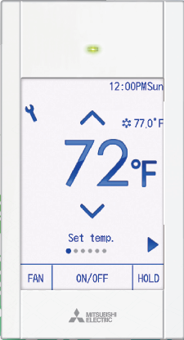
Caracteristicas Claves
PAR-CT01MAU-SB
Features
Control Bluetooth de 33’
Full color, touch screen display
Bluetooth app for users & installer
Can display customer logo
Scheduling ability
Controls 1-16 indoor units
MA style wiring
Wires directly to indoor unit
Reduced MA wire length
70m (229’) because of power consumption
NOT standard 656 ft. wire length
No Sub MA remote
Alguien dijo Bluetooth?

Slide 22

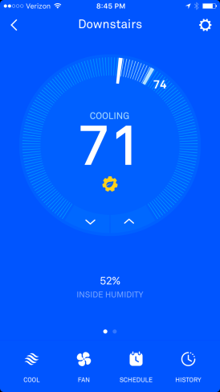
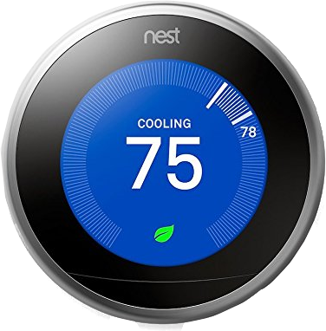
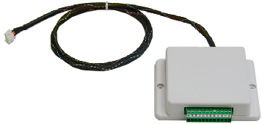
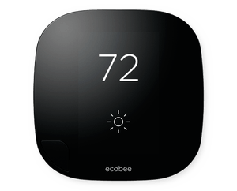
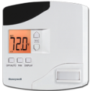
Caracteristicas Clave
Thermostat Interface
M&P or CITY MULTI
One interface per indoor unit
Modes:
Cool, Heat, Fan, and Off
Fan Speed Control
High, Medium, Low
CN-105
Thermostat Control
PAC-US444-CN-1
Nest? ecobee? Sin problema!

Slide 23
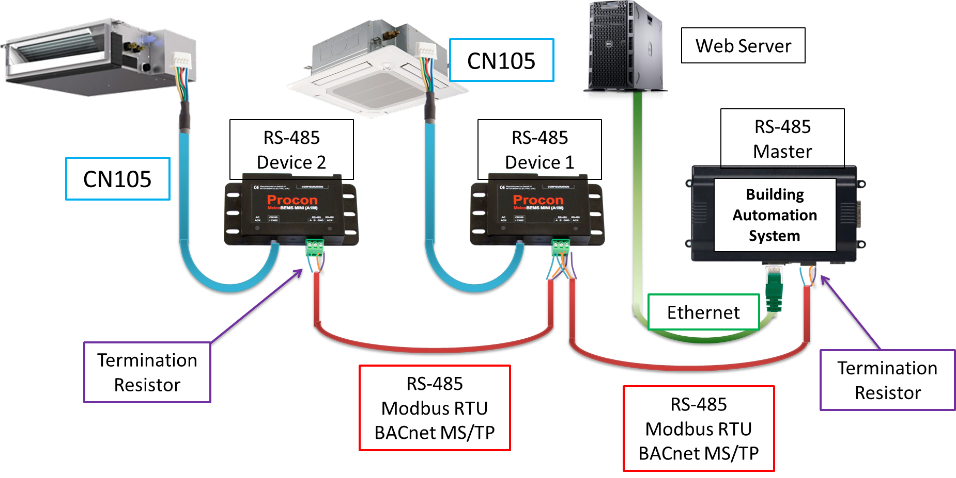
Key features and Sweet Spots!
Procon Interface- PAC-UKPRC001-CN1-1
1:1 gateway for a single indoor unit
Configurable for BACnet or Modbus
Intended to add a stand-alone unit into an existing BAS
Supported for use with a central controller, unlike kumo cloud
Some applications:
10 or fewer units to integrate into a 3rd party BMS
Spot cooling in commercial buildings
IDF closets, Guard Houses, Kitchens
National companies with distributed locations
Retail and fast food
BMS para solamente 1 unidad de A/C? Lo podemos hacer!
Notes:
Procon PAC-UKPRC001-CN1
1-to-1 connection for 1 indoor unit
Configurable for BACnet or Modbus
Used for an independent unit within an existing BAS
Compatible with central controller
P-series data closet control and monitoring

Slide 24
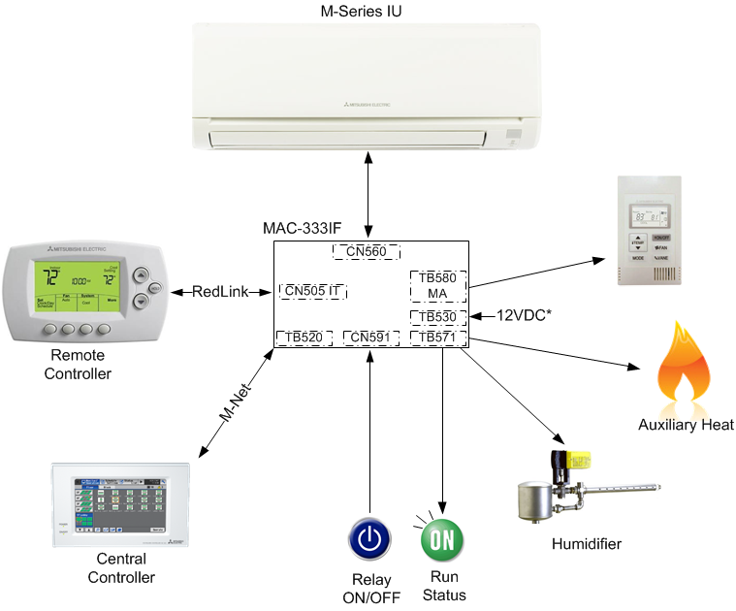
Caracteristica Clave
MAC-333IF-E - M-Series Control Adapter
M-NET ➔ Centralized Controller, BACnet, or LonWorks
To send status output to BMS
As a centralized On/Off control for indoor units or restricted operations
To check whether a unit in fault
So M-Series units communicate with our CITY MULTI Controls Network via M-Net
For back-up heating
Wired or Simple MA remote
**not required to add Simple MA on SEZ/SLZ/MVZ
CN-105
Tambien quiero integrar mi sistema mini split… Claro que Si!
Notes:
MAC-333IF
Interface to allow a standalone m-series residential minisplit to communicate with city multi controls.
Has two outputs for :
Equipment status and error
Humidifier control
Provides an input to allow remote on/off control of IDU
Packaged Handheld Wireless Remote (default option)
MHK1 Wall Mounted Wireless Remote
Compatible with Honeywell RedLink Internet Gateway for remote access using mobile apps or internet browser
MAC-333IF-E Control Adapter connected to each INDOOR unit
Allows for connection to M-NET
Requires 12VDC power supply if using MHK1 while connected to M-NET
Monitor and control from central controller
Tie into BACnet or LonWorks system through AE-200/50/EW-50 or LMAP04U
Allows for dry contact control
Requires 12VDC power supply
Remote Start/Stop
Error Status
Humidifier Enable
Supplemental Heat Enable
Allows for control by PAC-YT53CRAU Simple MA Remote

Slide 25
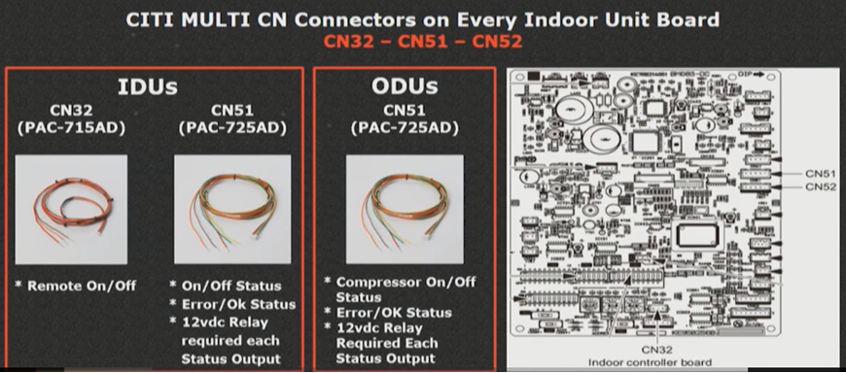
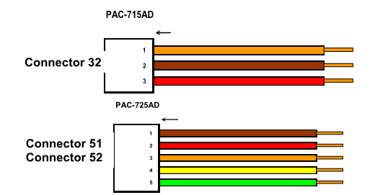
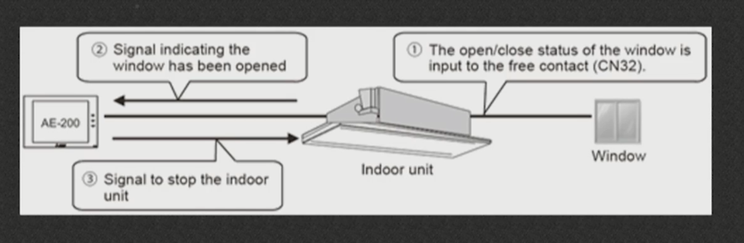
Caracteristicas Clave
Connectores 52, 51, and 32 se pueden usar como entradas y salidas libres.
Controladas usando progrmacion interconectada en el AE-200
SW1-9 y SW1-10 deben estar activados por IDU
Control de salida pulsada, bloqueo del ventilador, amortiguador de aislamiento, interruptor de ventana, etc.
Example:

Slide 26
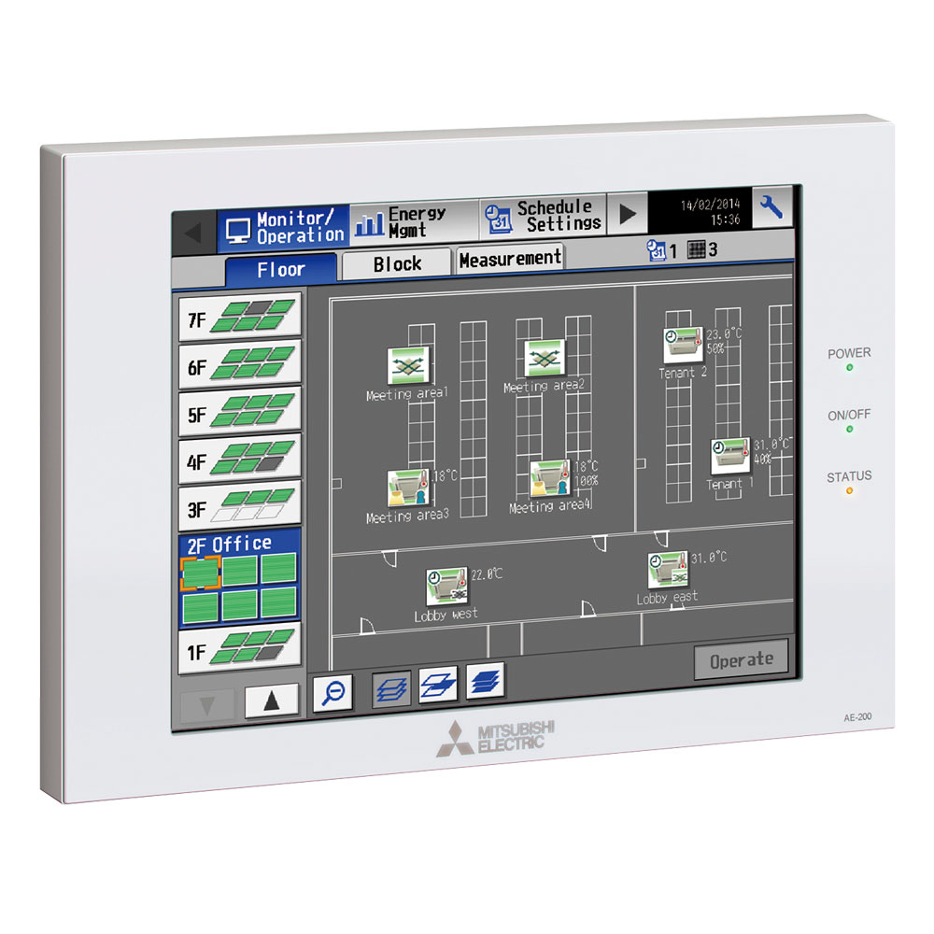
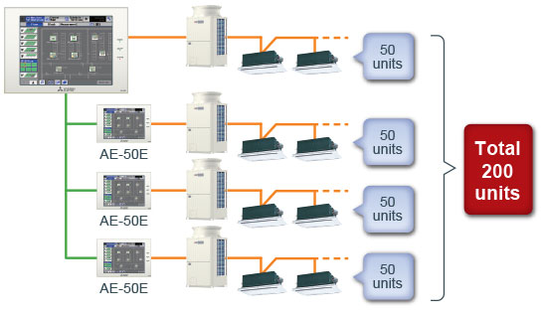
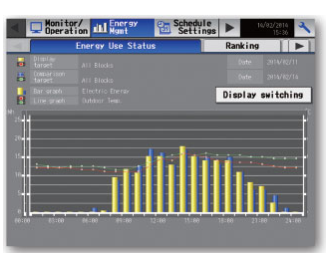
Caracteristicas Clave
AE-200
10.4” LCD color touch screen controller
Control of temperature, fan speed and airflow options at the touch of a button.
Comprehensive energy consumption monitoring and comparisons with the previous year's power consumption.
Control up to 200 units by using three AE50 expansion controllers.
Floor layout is displayed on the 10.4-inch LCD touch panel
PC Monitoring
PC Scheduling
Online Error Email
Online Maintenance Tool
Interlock Function
Optional Software Package
Tenant Billing
Personal Web Browser
Capable to connect to existing building’s LAN
Controls Indoor units, Lossnay, DOAS, PWFY, DIDO, AI, M-Series and P-Series
Compatible with BACnet and LONWorks Interfaces
Compatible with SW-Bacnet, SW-Charge, SW-P-web
Controlador Centralizado de Ultima Generacion!!!!

Slide 27

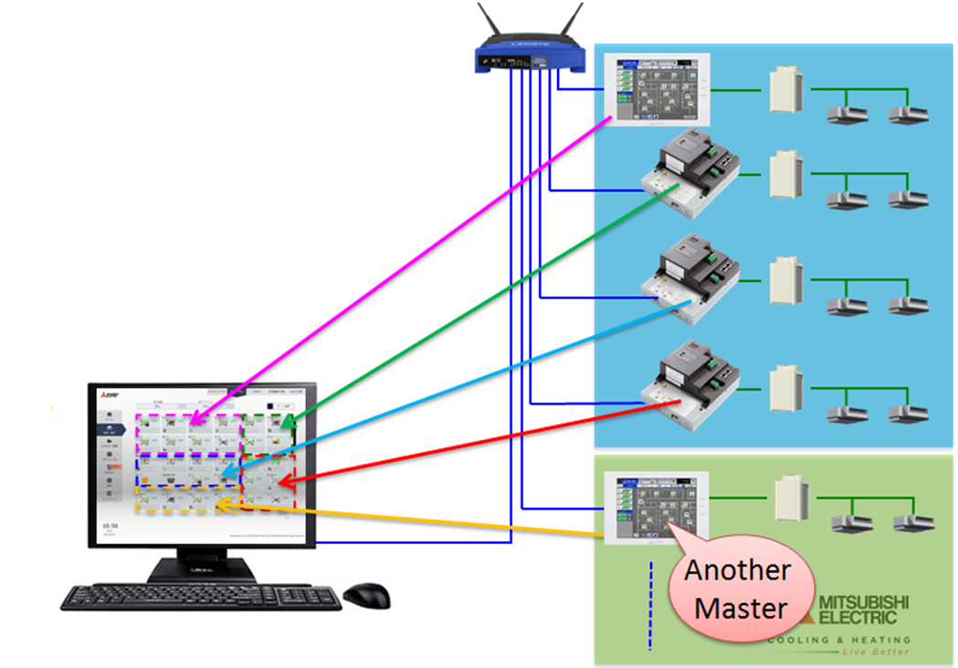

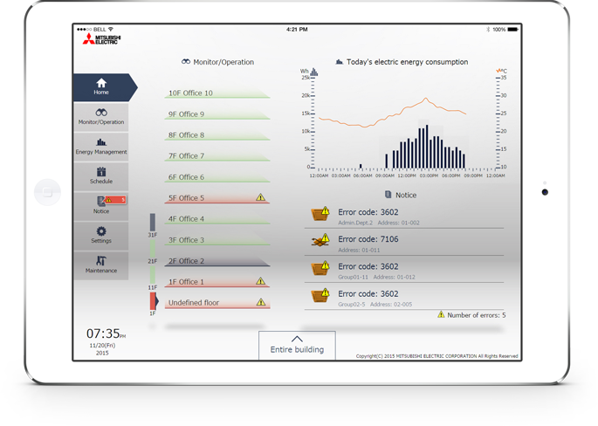
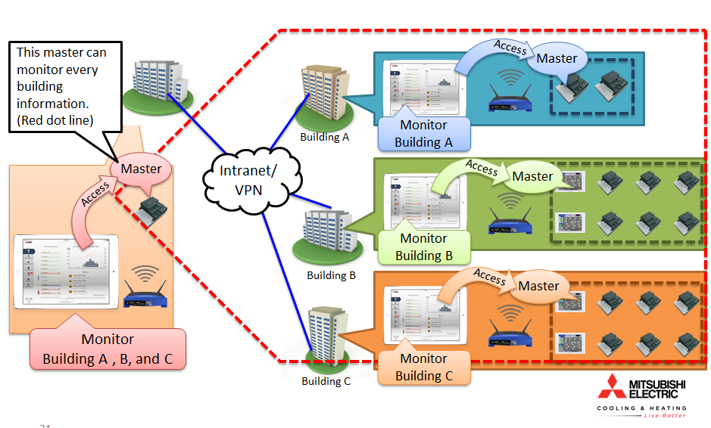
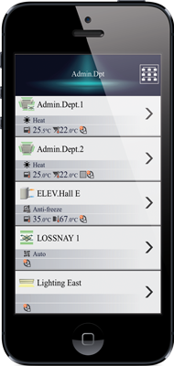
Caracteristicas Clave
Integrated Centralized Control Web (ICCW)
Controls various centralized controllers
With the ICCW, now you can control up to 100 AE-200’s
Capable of managing up to 2000 indoor units from one IP
Floor layout
Groups
Measurement / ACH status
Energy use status
Peak cut
Unit error log
Communication error log
Filter sign
Scheduling: today, weekly, annual
Send mail log
Outdoor Unit status
Un edificio o muchos … dejanos ensenarle como…
Notes:
ICCW (integrated centralized control web) is free. (see attached presentation on ICCW)
Scheduling
System errors
Screen display settings
Energy consumption (w/o meter) daily, annual
Condenser status
OU/IU free contact status CN32, CN51, CN52

Slide 28
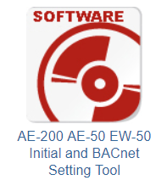
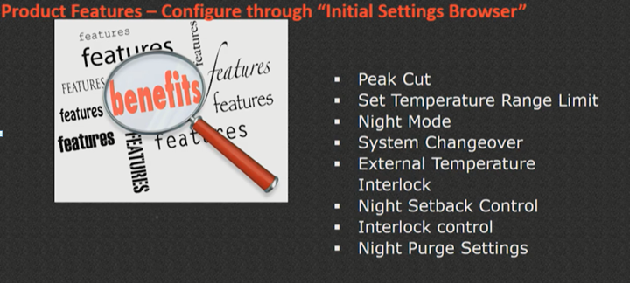
Caracteristica Clave
Initial Settings Tool
Ahorros, comfort, integracion…
Notes:
Several functions can be used via the initial settings browser (see attached presentation)
Peak Cut – where equipment reaching a peak, turn off equipment or change set point
Set Temperature range limit or limit ranges for user
Night mode – used when local codes restrict dB levels. You can reduce capacity of external equipment and thus dB to not exceed 60%-70%
System changeover
External temperature interlock
Night setback control – turn off IDU’s to let them reach a cooler/hotter temperature depending on system setting. They will turn back on when they get to a certain limit that you’ve indicated. This changes your schedule due to last command wins.
Interlock control – lets you install motion detectors, ventilators, door switches. Let’s you control various aspects of the building.

Slide 29
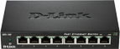










Caracteristicas Clave
Configuracion de Site para Aporcionamiento de Energia
AE-200
Collects energy data
PI Ctlr
Collects kWh Pulses
Tenant A
IDU Conditions set by tenant
Tenant B
IDU Conditions set by tenant
Expansion Ctlr
Hosts M-NET network
Charge Calc Tool
Prints spreadsheet
kWh Pulse Meter
Measures ODU kWh use
Ethernet Connection
M-NET Connection
ODU Electrical Supply
kWh Pulse Output
Contabilidad de inquilino conduce a la reduccion de los costos energeticos.

Slide 30





Recursos
Su punto de acceso principal para obtener información: www.mylinkdrive.com
Envíos, especificaciones, AutoCAD, REVIT, manuales de ingeniería y mucho más.
Otro buen recurso: www.mitsubishipro.com
Casos de estudio, guías de diseño, libros blancos, información de formación.
Almuerza y ​​aprende - ¡Habla con las personas que diseñan los sistemas! ¡Cuéntales sobre los puntos dulces! PPT disponible en el sitio de SharePoint sin conductos.
Las herramientas de selección, que estén disponibles!
Diamond System Builder (DSB) - UL y la nueva herramienta de diseño - No UL.
Venta financiera, el primer costo no es la única variable en la ecuación.

